Slide 1
Customer Complaints
Final Presentation

Slide 2
Introduction
Problem Identification
Formulation of Solution
Dataset
Data Wrangling
EDA
Data Pre-processing
Data Modelling & Results
Recommendations

Slide 3
Problem Identification
Context
There are numerous complaints which get filed by customers and solving these complaints effectively are essential for business as it poses many risks for a business like operational, reputational, litigations, etc.
Problem
Identify the financial product by reading through a complaint. Correctly, identifying the product will result in operational cost savings and mitigate risks of manual errors.
Scope
All complaints registered in the portal are in scope
Stakeholders
Operations Head of all LOBs, COO
Success Metrics
High Recall and Precision values

Slide 4
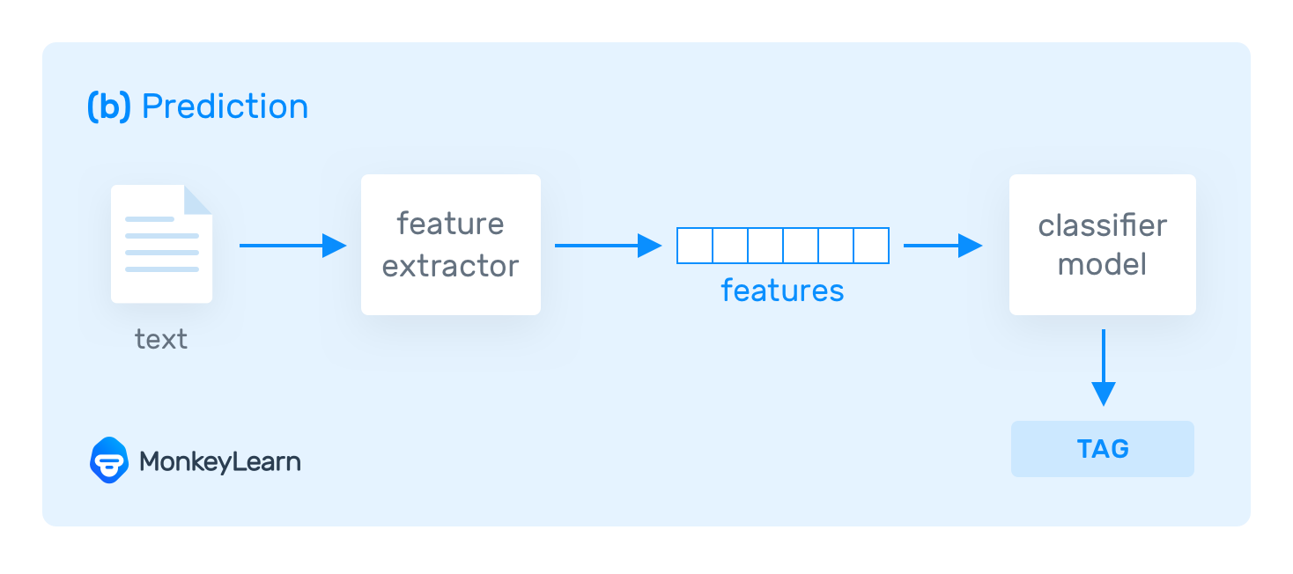
Formulation of Solution
The complaints dataset is formulated as a Natural Language Processing(NLP) problem. In this approach different algorithms are used to convert the text into features thus making it possible to use prediction algorithms.

Slide 5
Dataset
The Consumer Complaint Database is a collection of complaints about consumer financial products and services that is sent to companies for response. Complaints are published after the company responds, confirming a commercial relationship with the consumer, or after 15 days, whichever comes first.
https://cfpb.github.io/api/ccdb/
For the scope of this problem, I have focused only on extracting data for JP Morgan Chase which is my current organization. It is extracted from the above website which is a public source and in no way a JPMC internal/confidential data.
The data set features are called out towards the right and are self-explanatory
Product feature is the target feature/variable
Consumer complaint narrative is text submitted by customer
Features
Date received
Product
Sub-product
Issue
Sub-issue
Consumer complaint narrative
Company public response
Company
State
ZIP code
Tags
Consumer consent provided?
Submitted via
Date sent to company
Company response to consumer
Timely response?
Consumer disputed?
Complaint ID

Slide 6
Data Wrangling
Data Type Casting
The available data is not in the correct data type which down the line causes problems in further analysis. All features were correctly identified and types casted to solve for the problem that may arise later
Imputation
For this problem, the data where complaints were missing is removed from being moved further as it will not add any value while vectorizing
Takeaways
- The data contains around 78K observation/data points and around 18 features. For this problem, the customer narrative is important to predict the products however only around 21K data points are non-null hence the rest of the data points are dropped

Slide 7
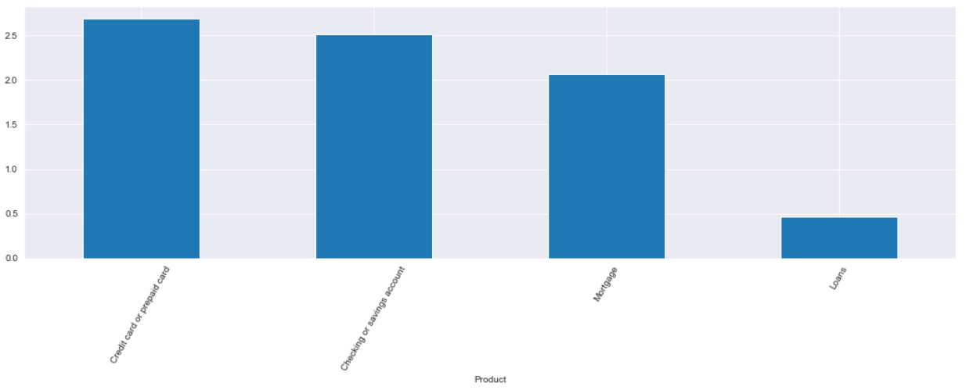
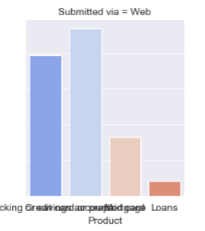
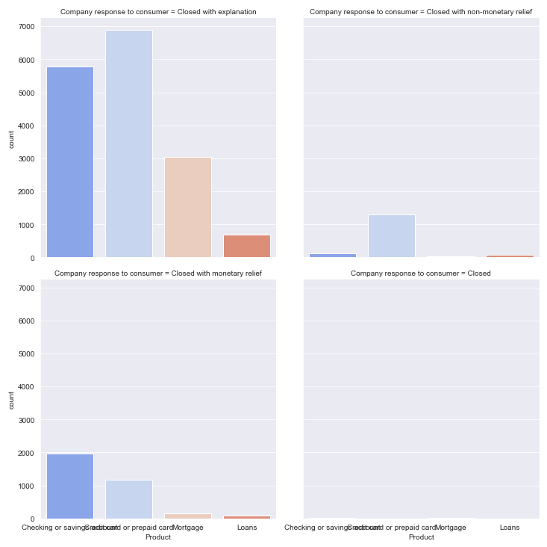
Exploratory Data Analysis
Takeaways
Takeaways
Highest numbers i.e. more than 40% of complaints are related to Credit and Prepaid cards
All of the requests are submitted via Web
The State referred as ‘CA’ accounts for 17% of the total complaints
Company attempt has been to close out complaints after explaining the issue in all the categories

Slide 8
Pre-processing
The complaints text is cleansed using various NLP techniques to make it easier for extracting features. The techniques that I considered are listed below
De-contraction
Stop word removal
Removing punctuations, masked details
Subsequently, the data becomes available for vectorization or creating features. In this stage Bag of words and Tf-Idf techniques are used with a limit if 5000 features

Slide 9
Machine Learning
After carefully vectorizing the comments and making it ready for modelling, the data is split in 70:30 ratio for training and testing the performance of models under consideration. There are 4 models which I considered and are listed below:
Logistic Regression
K-NN
Random Forest
XG Boost

Slide 10
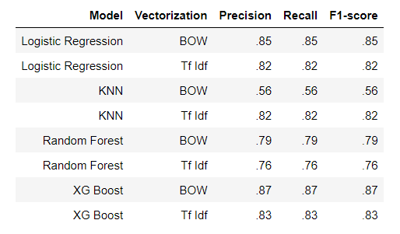
Model Results & Selection
XG Boost comes out as having the highest precision and recall with test data set therefor is chosen

Slide 11
Recommendation
Utilize the predictions in the business by deploying the chosen model. As with leveraging machine learning operations can generate a cost saving and have a faster turn-around-time with responding to complaints

